Slide 1
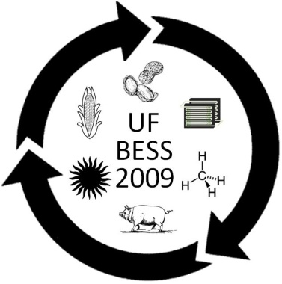
Haiti
Overview of Environmental Conditions and Economic Issues
Christa Rummel and Taylor Norrell
UF –IFAS BioEnergy Summer School Interns
Dr. Ann Wilkie
Soil and Water Science
54% of Haitians live on 1$ a day
78% live on 2$ a day

Slide 2
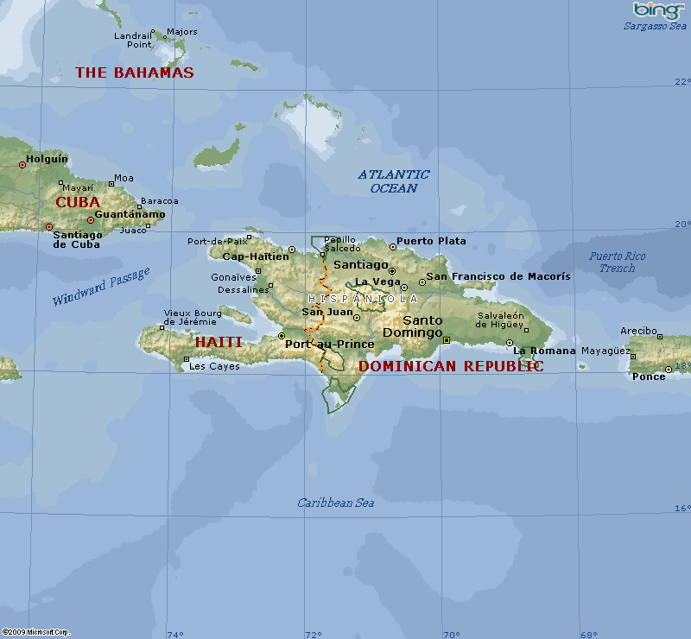
Notes:
Population: 9.6 Million
6.2 million live below the poverty line
Land Mass: 11,000 square mi
About the size of Maryland
Official Languages: Creole and French

Slide 3
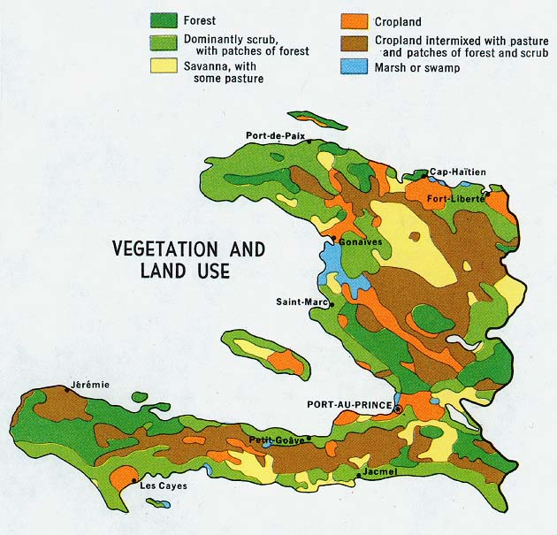
Notes:
Limited forests and crop put limits on resources

Slide 4
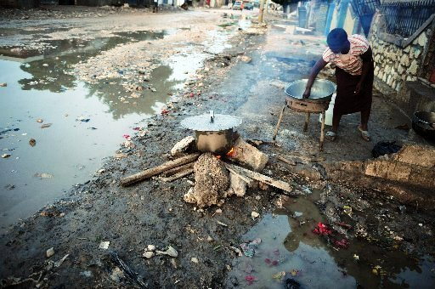
ENERGY ISSUES
Notes:
Nearly 7.2 of the 9.6 million Haitians lack access to reliable energy.
The primary use of energy is for cooking and wood is the primary fuel.
This has led to extreme deforestation that in return has caused extreme soil depletion and erosion.
This depletion and erosion has lead to major issues with the depletion of resources
Only about 12.5% of Haitians have electricity, the majority of electricity used is powered by generators that run on diesel fuel. As a result much of their income is used to buy fuel to run these generators.

Slide 5
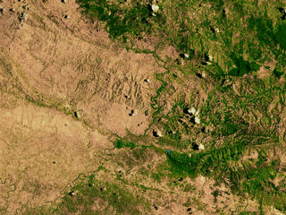
Border of Haiti and Dominican Republic
Notes:
This aerial view shows the border between Haiti (on the left) and the Dominican Republic (on the right).
It is a good view of how the deforestation has drastically changed the land in comparison to what it once was and why there have been so many issues associated.

Slide 6
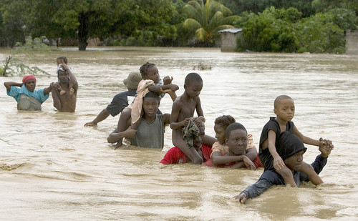
SOIL ISSUES
Notes:
Due to the erosion and depletion of the soil from the deforestation there is a limit to the crops that can be grown.
The erosion is caused by the mountainous topography and the frequent tropical storms and hurricanes that are common in the Caribbean causing frequent flooding.
Haiti’s dominant cash crops include coffee, mangoes, and cocoa. Haiti has decreased its production of sugarcane, traditionally an important cash crop, because of declining prices and fierce international competition. Because Haiti’s forests have thinned dramatically, timber exports have declined.

Slide 7
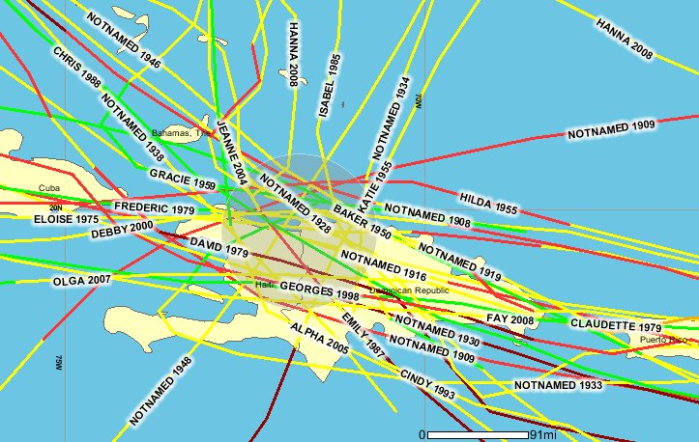
Notes:
Storms that have hit Haiti in the past 100 years

Slide 8
Storms that have hit Haiti in 2008

Slide 9
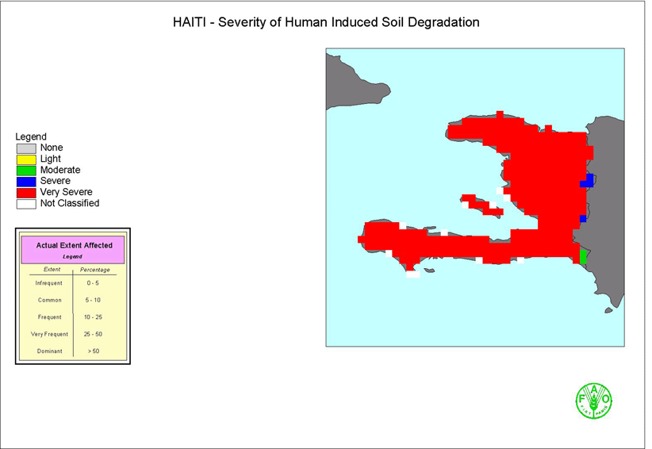

Slide 10
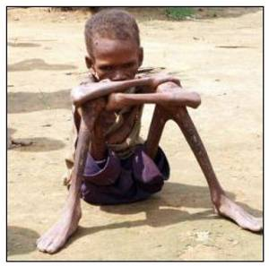
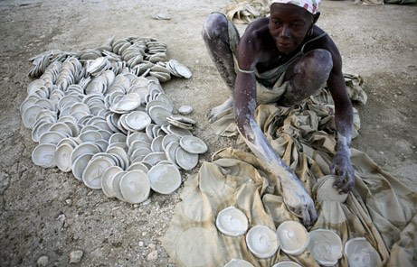
FOOD ISSUES
http://www.youtube.com/watch?v=oqAF9K39PXw
Notes:
Due to the lack of farmable land and resources most of the people in Haiti are starving, so much that they have developed a way to make cookies from mud to help with the pain of hunger. Among other reasons this is bad because of pathogens that are able to be ingested especially due to their sanitation practices

Slide 11
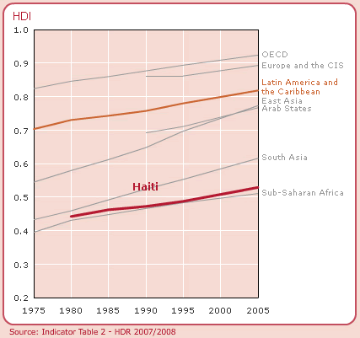
Notes:
The HDI provides a composite measure of three dimensions of human development: living a long and healthy life (measured by life expectancy), being educated (measured by adult literacy and enrolment at the primary, secondary and tertiary level) and having a decent standard of living (measured by purchasing power parity, PPP, income).
The HDI measures the average progress of a country in human development.
By looking at some of the most fundamental aspects of people’s lives and opportunities it provides a much more complete picture of a country's development than other indicators, such as GDP per capita.
(East Asia and South Asia have accelerated progress since 1990. Central and Eastern Europe and the Commonwealth of Independent States (CIS), following a catastrophic decline in the first half of the 1990s, has also recovered to the level before the reversal. The major exception is sub-Saharan Africa. Since 1990 it has stagnated, partly because of economic reversal but principally because of the catastrophic effect of HIV/AIDS on life expectancy.)

Slide 13
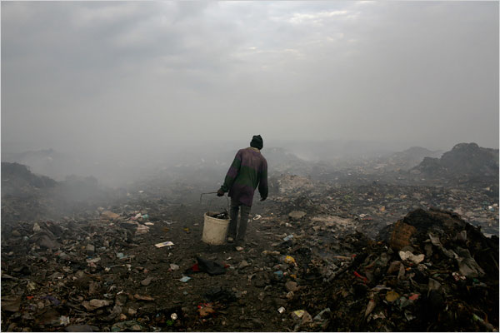
HEALTH ISSUES
Notes:
According to the World Health Organization
The majority of children born in Haiti came into this world on a dirt floor. 1 out of 8 children die before they reach the age of five.
the leading causes of death for infants and children are acute diarrhoeal diseases (12.1%), infections of the perinatal period (10.2%), malnutrition (9.1%) and acute respiratory infections (6.9%).
• HIV/AIDS adult prevalence rate in Haiti is estimated at 5.6%. AIDS is the leading cause of death for both adolescents and adults with respectively 5.8% and 21.6% of deaths with specifically de-fined diagnosis. With an estimated adult HIV prevalence rate of 2.3%, the Caribbean is the second worst-affected region in the world after sub-Saharan Africa.

Slide 14
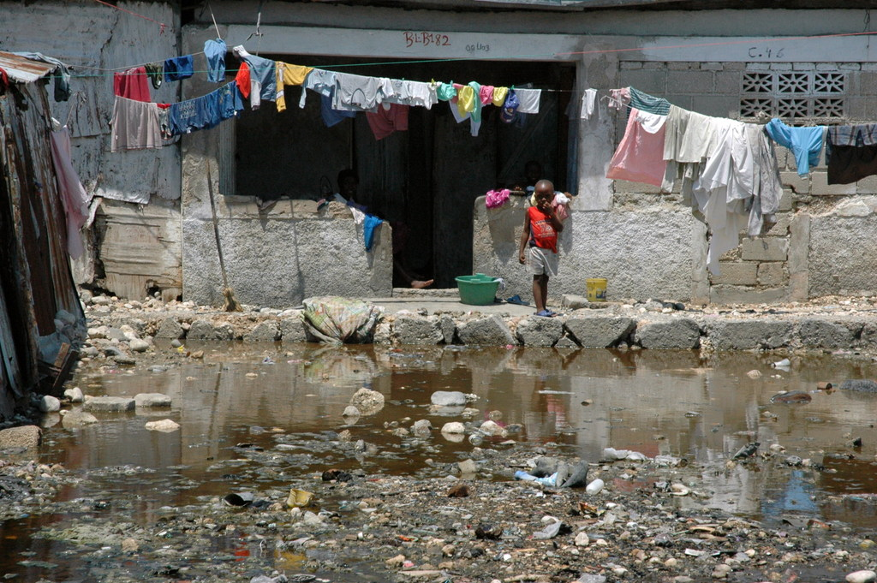
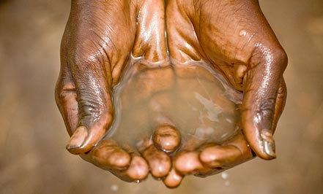
WASTE MANAGMENT
Notes:
Sewer systems and wastewater treatment are nonexistent.
Water, crops and fish are exposed and contaminated by raw sewage
Only 50% of population have access to potable water supply
As mentioned in the video, bacterial contamination is a major health issue in Haiti. A major source of contamination comes from raw sewage that is left unmanaged and untreated. This sewage spreads pathogens to contaminate Haiti’s limited food supply and leave’s approximately half of the population without a supply of potable water
Bacterial contamination health issue → unmanaged/untreated raw sewage → food supply and ½ pop

Slide 15
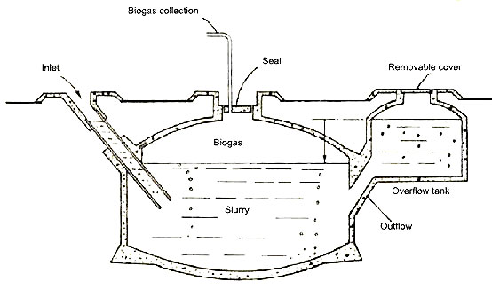
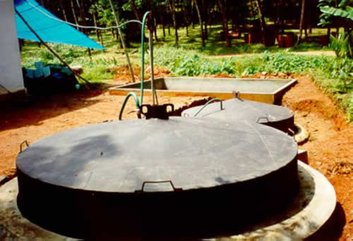
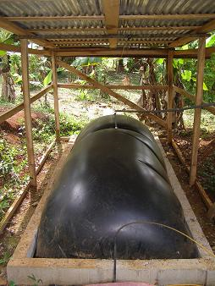
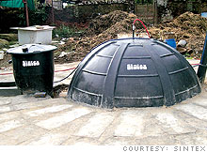
A Solution?
BIOGAS used around the world…..
India
Kenya
Costa Rica
Notes:
Here are various examples of rural villages using anaerobic digesters to manage and treat raw sewage, creating a pathogen-free fertilizer and a supply of biogas
rural villages manage/treat raw sewage → creates pathogen-free fertilizer/biogas

Slide 16
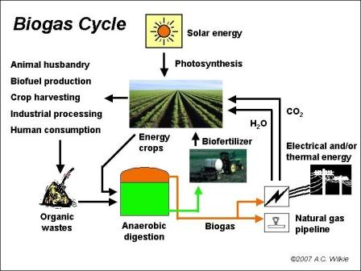
How is Biogas Made?
Notes:
In an anaerobic (free of oxygen) digester microorganisms break down the organic material (from wood to vegetables or in this case human and animal excreta) into sugar and acids, which then become gas. Mostly methane which is called biogas that can be used as fuel for cooking, lights, and much more. The slurry that remains from the digestion process is good fertilizer, and considerably reduces pathogens in waste.
Biogas is produced by the decomposition of organic waste in oxygen free conditions. Complex organic molecules are broken down by anaerobic bacteria to produce a methane rich gas.
produced by decomp. of organic waste, oxygen free conditions → complex organic molecules broken down by anaerobic bacteria to produce methane

Slide 17
Anaerobic Digester
Energy Issues: The Biogas that an anaerobic digester produces can be used as fuel for cooking
Soil Issues: The slurry can be used directly on the soil as a free fertilizer
Health Issues: The pathogens are drastically reduced and the waste is managed.
Food Issues: Do to the increase in nutrients in the soil from the slurry, crops can be grown easier with a better chance of survival
Economic Issues: An anaerobic digester is capable of turning the unmanaged waste that is causing major health issues and turning it into a valuable fertilizer and energy source
Notes:
As was mentioned, biogas can be used as an energy source for cooking and heating applications, helping to reduce deforestation and provide clean, renewable energy.

Slide 18
THANK YOU

